Slide 1
CS 464 Project
Telecom Customer Churn Rate Prediction
Group 5 Alba Mustafaj 21500009
Alp Ege Baştürk 21501267
Berat Biçer 21503050
Bora Ecer 21501757
H. Buğra Aydın 21501555

Slide 2

Introduction & Project Description
The objective of this project is predicting user’s churn rate, which occurs when a customer stops using the service.
Predicting whether a customer is leaving or not at the end of the contract term is done by looking at the customer’s data according to the features determined at the time of training.
Prediction accuracy is the main problem
Person in doubt [1]

Slide 3
Dataset Description
The dataset to be used is that of Telco’s Customer Data [2]
The raw data contains 7043 rows (customers) and 21 columns (features).
customerID Customer ID | gender Customer gender (female, male) | SeniorCitizen Whether the customer is a senior citizen or not (1, 0) | Partner Whether the customer has a partner or not (Yes, No) | Dependents Whether the customer has dependents or not (Yes, No)

Slide 4
Features
customerID
Gender,
SeniorCitizen
Partner,
Dependents
Tenure
PhoneService
MultipleLines
InternetService
OnlineSecurity
OnlineBackup,
DeviceProtection
TechSupport
StreamingTV
StreamingMovies
Contract
PaperlessBilling
PaymentMethod
MonthlyCharges
TotalCharges
Churn
Notes:
customerID
Customer ID
gender
Customer gender (female, male)
SeniorCitizen
Whether the customer is a senior citizen or not (1, 0)
Partner
Whether the customer has a partner or not (Yes, No)
Dependents
Whether the customer has dependents or not (Yes, No)
tenure
Number of months the customer has stayed with the company
PhoneService
Whether the customer has a phone service or not (Yes, No)
MultipleLines
Whether the customer has multiple lines or not (Yes, No, No phone service)
InternetService
Customer’s internet service provider (DSL, Fiber optic, No)
OnlineSecurity
Whether the customer has online security or not (Yes, No, No internet service)
OnlineBackup
Whether the customer has online backup or not (Yes, No, No internet service)
DeviceProtection
Whether the customer has device protection or not (Yes, No, No internet service)
TechSupport
Whether the customer has tech support or not (Yes, No, No internet service)
StreamingTV
Whether the customer has streaming TV or not (Yes, No, No internet service)
StreamingMovies
Whether the customer has streaming movies or not (Yes, No, No internet service)
Contract
The contract term of the customer (Month-to-month, One year, Two year)
PaperlessBilling
Whether the customer has paperless billing or not (Yes, No)
PaymentMethod
The customer’s payment method (Electronic check, Mailed check, Bank transfer (automatic), Credit card (automatic))
MonthlyCharges
The amount charged to the customer monthly
TotalCharges
The total amount charged to the customer
Churn
Whether the customer churned or not (Yes or No)

Slide 5
Data Preprocessing
Initial dataset included non numeric fields like gender and true/false fields, missing data and hashed user ID

Slide 6
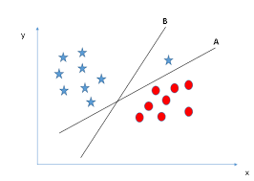
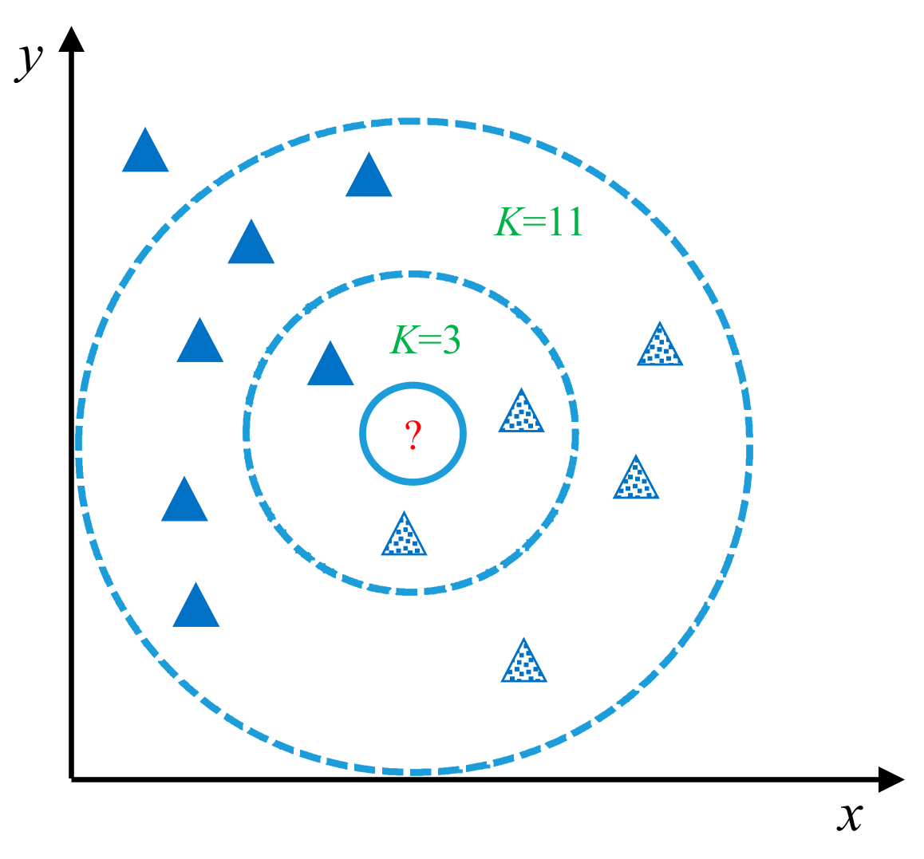
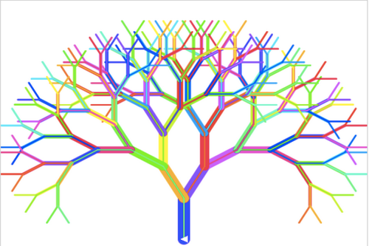
Methods
Following methods were used:
SVM
kNN
logistic regression
decision tree
random forest
Neural Networks
Success of different methods will be compared to find optimal one(s).
SVM [4]
Knn [3]
Random forest [5]

Slide 7
Train/Test Split & Cross Validation
Used Train/Test split for generalizable models
Applied cross validation for:
SVM
Logistic Regression
kNN
Decision Tree
Random Forest

Slide 8
Feature & Parameter Selection
Used to find optimal parameters and features
Feature selection was used to improve time
Parameter selection was used to improve accuracy

Slide 9
Results
All experiments aimed to find optimal accuracy using that model.
The experiments we have followed were to answer the following questions:
Which are the best hyper parameter values that results with the highest accuracy?
Which are the best features that results with the highest accuracy once used with the best hyper parameters?
Which train/test split is better in terms of accuracy?
What is the relationship between the selected feature amount and the accuracy?
What are the ROC, Precision-Recall results?

Slide 10
SVM
Parameters:
Kernel, C, gamma
C parameter gives regularization. For large C it acts like hard margin.
Gamma determines influence of further data points on the calculation.
Recursive feature elimination was used in order to get first i best features.
Hyperparameter selection was applied in order to choose kernel type, C and gamma parameters.

Slide 11
SVM Results
Test set ratio = 40%
Choosing larger or smaller test sets didn’t have significant effects, thus no graphs were drawn since results were inseparable from noise.
In the case where test set was chosen as 5%, accuracy fluctuated between 78-83%

Slide 12
SVM Results
Accuracy: 80.207%
Confusion Matrix:
Actual \ Predicted | 0 | 1
0 | 1906 | 173
1 | 386 | 353
 | precision | recall | f1-score | support
0 | 0.83 | 0.92 | 0.87 | 2079
1 | 0.67 | 0.48 | 0.56 | 739
micro_avg | 0.8 | 0.8 | 0.8 | 2818
macro_avg | 0.75 | 0.7 | 0.72 | 2818
weighted_avg | 0.79 | 0.8 | 0.79 | 2818
Notes:
Obtained using all features

Slide 13
SVM Results
Best Features:
Best feature: tenure
Best 3 features: tenure, InternetService, Contract
Best 5 features: tenure, InternetService, OnlineSecurity, Contract, TotalCharges
Best 7 features: tenure, InternetService, OnlineSecurity, TechSupport, StreamingMovies, Contract, TotalCharges
Best 10 features: tenure, InternetService, OnlineSecurity, TechSupport, StreamingTV StreamingMovies, Contract, PaperlessBilling, MonthlyCharges, TotalCharges
Best Parameters:
kernel: rbf
C: 100
gamma: 0.001
Notes:
Grid search CV was used for parameter selection

Slide 14
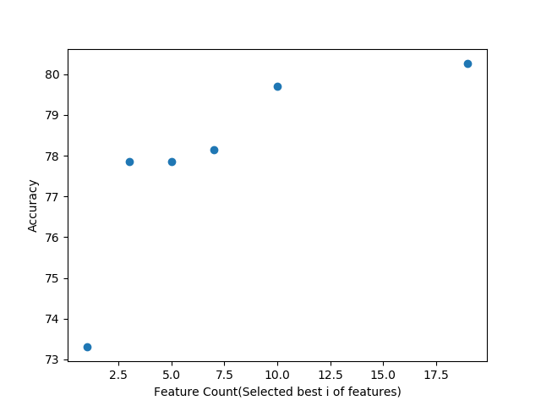
SVM Results

Slide 15
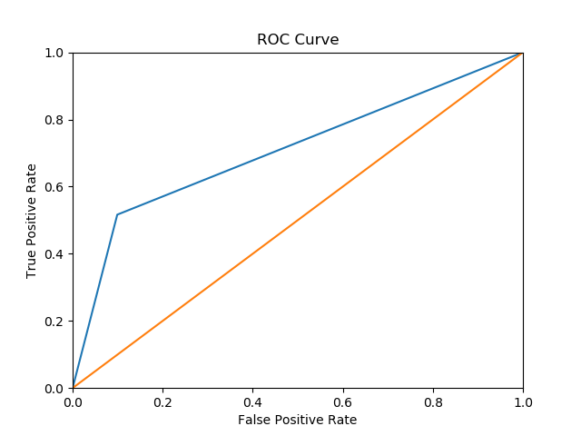
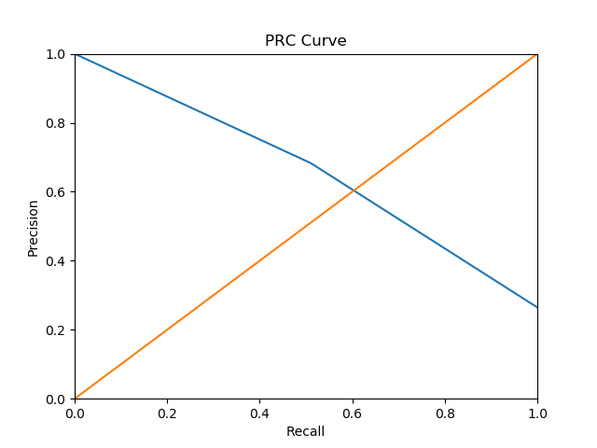
SVM Results

Slide 16
SVM Discussion
Feature selection was not helpful for the accuracy
All 19 features were used in order to calculate curves and accuracy since it was not expensive.
Hyperparameter selection gave rbf kernel as the best choice, which was expected from our dataset.
SVM is a good model considering it’s simple enough to train and predict and also it provides sufficient accuracy to solve the problem. If necessary, first three features might be used in order to improve performance while sacrificing negligible accuracy.
Notes:
Thoug it gave information that best 3 features provide sufficient accuracy.

Slide 17
Neural Network
2 NNs were used, one simple and one complex one.
Feature selection was applied
No parameter selection was applied
Notes:
Neural networks were not expected to be main focus of the project since other methods were expected to provide sufficient accuracy according to initial tests.
Results from the neural network experiments were used to support the limitations of dataset on the accuracy.

Slide 18
Neural Network Results
Test set ratio = 40%
Simple one with three layers with 20, 5 and 1 nodes.
More complex one with 6 layers of 200, 150, 100, 50, 25, 1 nodes.
Purpose of this experiment is finding a network which is fast and does not overfit the data.

Slide 19
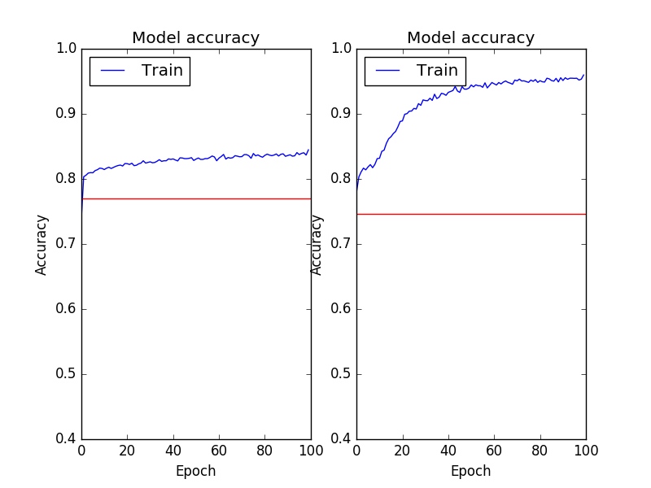
Neural Neural Network Results
19 Features
Notes:
Blue line is the accuracy on the train set
Red line is the final accuracy on the test set.

Slide 20
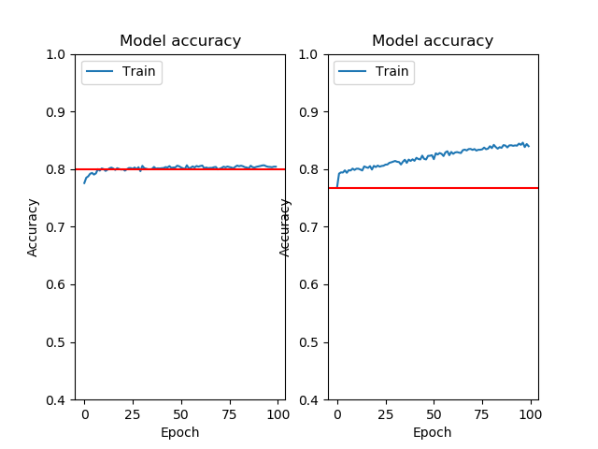
Neural Network Results
Best 10 Features
Notes:
Blue line is the accuracy on the train set
Red line is the final accuracy on the test set.

Slide 21
Neural Network Discussion
Both models overfit without feature selection
Only complex network overfits when using best 10 features
Test set accuracy is capped around 80%, which is also reached by other methods.
Thus NN is not optimal because of training time
Notes:
NN is overkill
Helps finding the bound of the dataset since even complex models cannot pass the 80% reliably

Slide 22
Decision Tree
Parameters:
Impurity criterion: gini or information gain using entropy
Maximum depth of the decision tree
Minimum number of samples required to be at a leaf node
Minimum number of samples required to split an internal node
Splitter strategy: best or random

Slide 23
Decision Tree
Hyper parameter selection with 5-fold cross validation applied to different combinations of the parameter values.
Then feature selection for different test/train ratios were conducted using the best hyper parameter values to find best accuracy.

Slide 24
Decision Tree Results
Best Parameters
Maximum Depth: None
Min. number of samples required to be at a leaf node: 40
Min. number of samples required to split an internal node: 68
Splitter Strategy: Best
Best feature set = Contract, StreamingMovies, TechSupport, InternetService, MultipleLines, Dependents.
Best train/test ratio: 6/4
Best overall accuracy: % 79

Slide 25
Decision Tree: Results
Confusion Matrix:
Actual \ Predicted | 0 | 1
0 | 1903 | 165
1 | 419 | 331

Slide 26
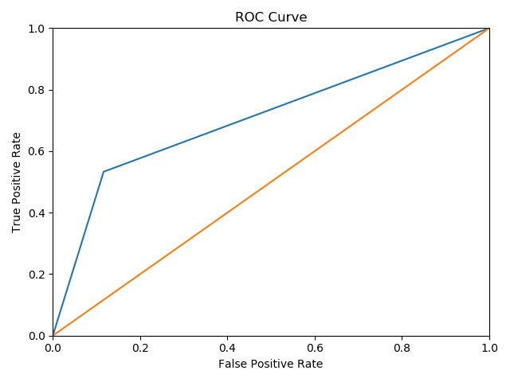
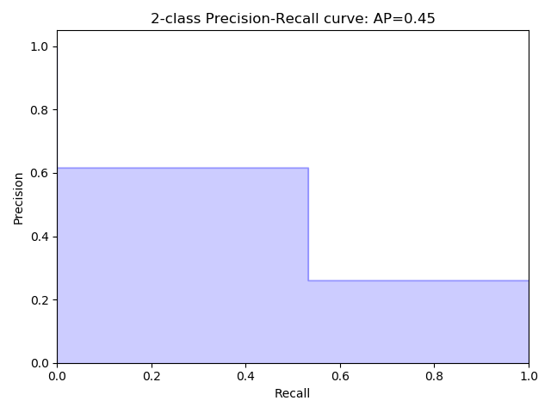
Decision Tree: Results

Slide 27
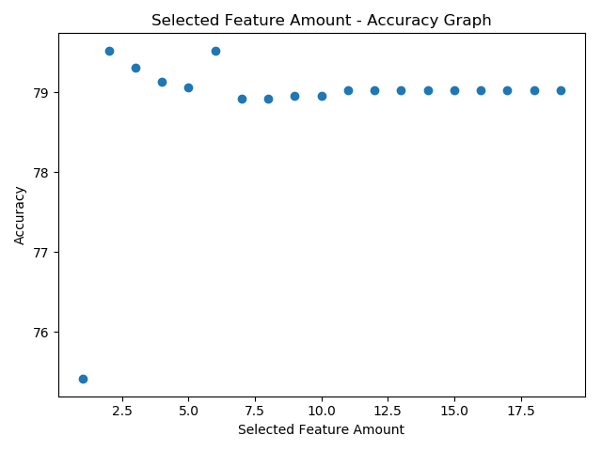
Decision Tree: Results

Slide 28
Decision Tree: Discussion
Hyper parameter selection was helpful.
However the accuracies with the best parameters and with the default values was close to each other.
Feature Selection did slightly improved the accuracy.
In terms of overall performance, Decision Tree model is stable. It performs similarly in most of the cases.

Slide 29
Logistic Regression
Parameters:
penalty
Tol
Dual
fit_intercept
solver
multi_class

Slide 30
Logistic Regression
Parameters:
multi_class : ‘ovr’ for binary classification
Solver : ‘Liblinear’ as it is more suitable for the size of our dataset
Dual : False, as the number of samples > number of features
fit_intercept, tolerance and penalty tuned experimentally
Notes:
penalty specifies the penalty norm
Tol tolerance for stopping criteria,
Fit_intercept specifies if a constant should be added to the decision function.
Solver identifies the algorithm to be used in optimization
multi_class should be set to ovr in order to be applicable for the binary classification problem.

Slide 31
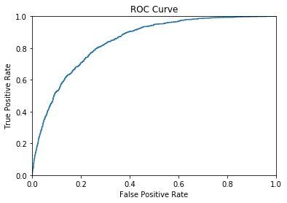
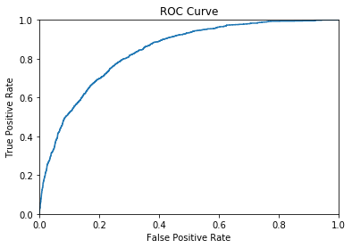
Logistic Regression
Penalty ‘l1’ vs ‘l2’:
Slight accuracy improvement of 1% and tpr over fpr for penalty to ‘l2’
Tolerance set to 1e-4 was better with:
Accuracy: 0.804
Precision: 0.79
Recall: 0.80
fit_intercept False vs “True”
Adding constant improved accuracy by 9.2% as well as tpr over fpr

Slide 32
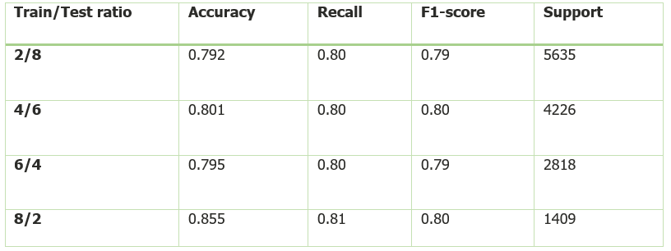
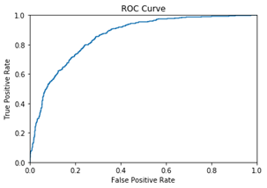
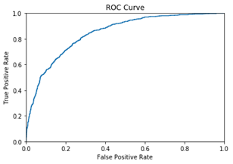
Logistic Regression
Train/Test split:
Accuracy range 79%-81%
79% :traineset 20% of the whole dataset.
81% traineset 80% of the whole dataset.
ROC curves for different cases do not differ substantially from each other (left 4/6, right 2/8)

Slide 33
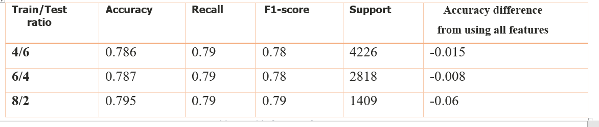
Logistic Regression
Feature Selection:
SelectKBest with chi score function and 5 top features:
Top Features:tenure, online security, contract, monthly charge, total charge.
Reducing to 3 gave almost identical results and tenure, monthly charge, total charge as top features.
Notes:
Very small accuracy difference from when 19 features were used.

Slide 34
Logistic regression
Cross validation:
Trials for seven train/test sizes and number of folds were conducted.
Having 4 number of folds yielded worse results than not using CV.
Best results if the trainset contains about 40% of the whole dataset and the nr of folds = 40.
Icreasing trainset beyond 40% does not yield better accuracy, as it did in the very first case with no cross validation.

Slide 35
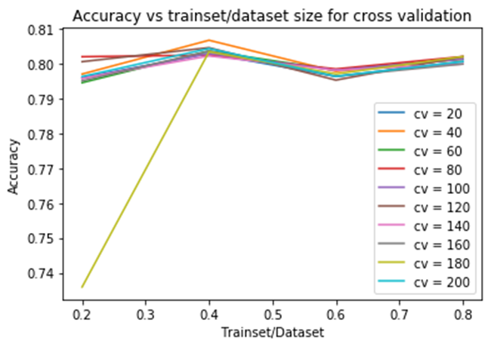
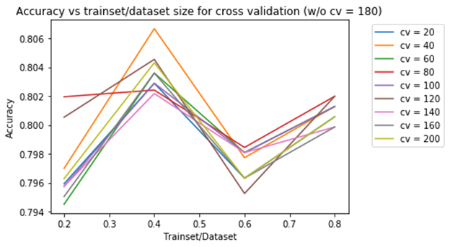
Logistic Regression

Slide 36
Random Forest Classification
Parameters:
Decision Tree Amount
Maximum Depth
Minimum Samples to Form A Leaf
Maximum Leaf Nodes

Slide 37
Random Forest Classification
Hyper parameter selection with 5-fold cross validation applied to different combinations of the parameter values.
Then feature selection for different test/train ratios were conducted using the best hyper parameter values to find best accuracy.

Slide 38
Random Forest Results
Best Parameters
Number of Decision Trees: [1, 5, 10, 100]
Maximum Leaf Nodes: [10, 100, 1000, None]
Max Depth: [1, 10, 100, None]
Min Samples Required In Leaf: [1, 2, 5, 10]
Best feature set = Tenure, Contract, Monthly Charges, Online Security, Internet Service
Best test/train ratio: 0.3
Best overall accuracy: 0.7955

Slide 39
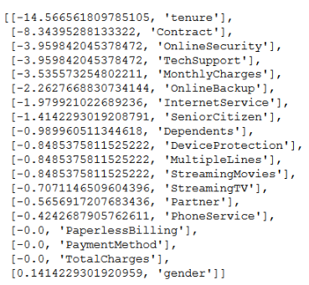

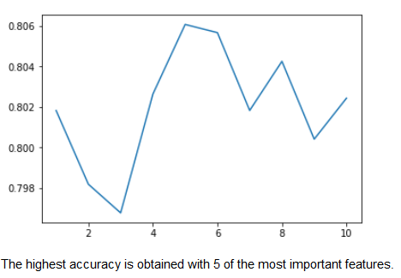
Random Forest Results
Confusion Matrix:

Slide 40
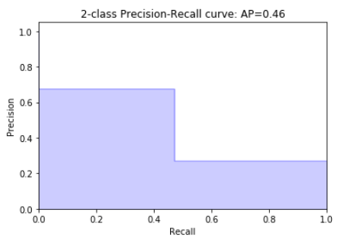
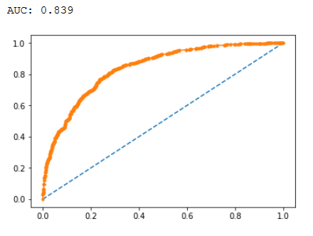
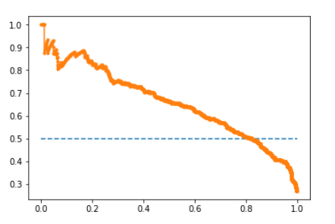
Random Forest Results

Slide 41
Random Forest Discussion
Tenure is the most important feature
Feature selection reduced complexity
It is hard to make comments on the hyper parameters since different decision trees generated in each iteration
Unstable approach with good results
If we don’t limit the maximum number of leaf nodes, the model overfits

Slide 42
kNN
Parameters
Number of closest neighbors
Weights assigned to samples
Selection of algorithm for computing nearest neighbors
Distance metric for any 2 points

Slide 43
kNN
Hyperparameter selection with experiments for K = [1, 25]
Feature Count selection with experiments for feature count = [1, 19]

Slide 44
kNN Results
Best Parameters
Number of closest neighbors K = 4
Uniform weights assigned to samples (default case)
Automatic selection of algorithm for computing nearest neighbors (default case)
Distance metric Minkowski with p = 2, equivalent to Euclidean L2 distance (distance)

Slide 45
kNN Results
Best Feature Set: ['tenure', 'OnlineSecurity', 'TechSupport', 'Contract', 'MonthlyCharges', 'TotalCharges'].
Best Test/Dataset Ratio: 0.25
Best Accuracy: 0.792

Slide 46
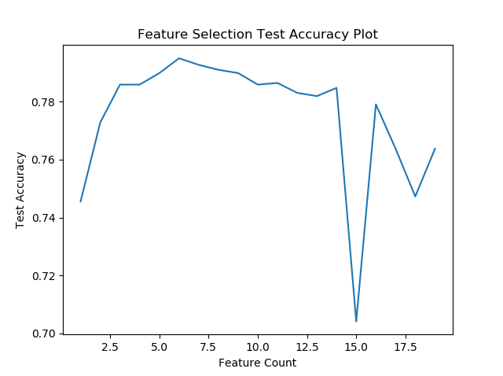
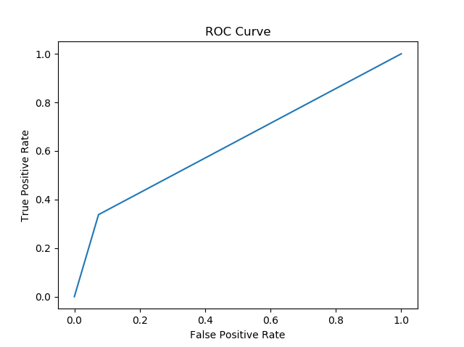
kNN Results

Slide 47
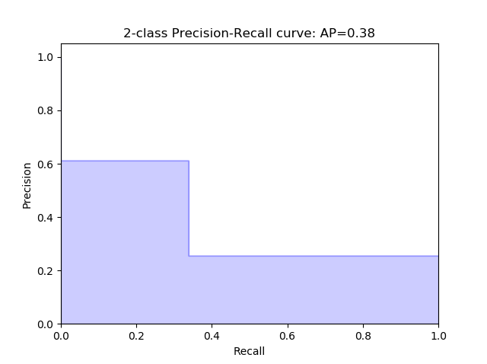
kNN Results

Slide 48
kNN Discussion
Feature selection reduced overfitting & model complexity
At large nearest neighbor count, K, noise increases & accuracy goes down
Fast to compute, relatively high accuracy
Alternative metrics of distance that are context sensitive might improve accuracy
Most frequent class dominates classification if data is skewed

Slide 49
6. Conclusion
Accuracy of most of the algorithms capped around 80%
Answer to the prediction problem is one of the classifiers, preferably the easiest the compute ones
In the future, better datasets can be used in order to increase prediction accuracy
Also our code for an experimental commercial use is extremely primitive. This code can be improved so that a user can interact with a GUI
Notes:
Accuracy of most of the algorithms capped around 80%. Thus, this might be the limit which can be reached using this dataset. A better dataset might provide better accuracy.
Answer to the prediction problem is one of the classifiers, preferably the easiest the compute ones. (So neural network is not optimal)

Slide 50
References
[1] Person in doubt, [Online]. Available: https://www.psychologytoday.com/au/blog/children-the-table/201806/when-child-tells. [Accessed: Oct. 11, 2018]
[2] Blast Char ”Telco Customer Churn”. Kaggle. [Online]. Available: https://www.kaggle.com/blastchar/telco-customer-churn. [Accessed: Oct. 2, 2018]
[3] knn Graph, [Online]. Available: https://www.google.com.tr/search?q=knn&source=lnms&tbm=isch&sa=X&ved=0ahUKEwi2xc-fgf_dAhXF_CoKHcdcAfoQ_AUIDygC&biw=1366&bih=613#imgrc=zWukqNn05iZXEM: [Accessed: Oct. 11, 2018]

Slide 51
References
[4] SVM Graph, [Online]. Available: https://www.analyticsvidhya.com/wp-content/uploads/2015/10/SVM_1.png. [Accessed: Oct. 11, 2018]
[5] Random forest animation, [Online]. Available: https://www.google.com.tr/url?sa=i&rct=j&q=&esrc=s&source=images&cd=&cad=rja&uact=8&ved=2ahUKEwim3Kjlgv_dAhUFzaQKHd0XCJ0QjRx6BAgBEAU&url=http%3A%2F%2Fcagriemreakin.com%2Fveri-bilimi%2Frandom-forest-classification-10.html&psig=AOvVaw3CyZGO5GS--DYwxZ2S1bZL&ust=1539369042818892. [Accessed: Oct. 11, 2018]

